Slide 1



Mars Dust: Where does it come from?
Rachel L. Fry¹ (rlf266@nau.edu), Dr. Devon Burr², Anna Baker²
¹Northern Arizona University, Department of Applied Physics and Materials Science, Flagstaff, AZ
²Northern Arizona University, Department of Astronomy and Planetary Science, Flagstaff, AZ

Slide 2
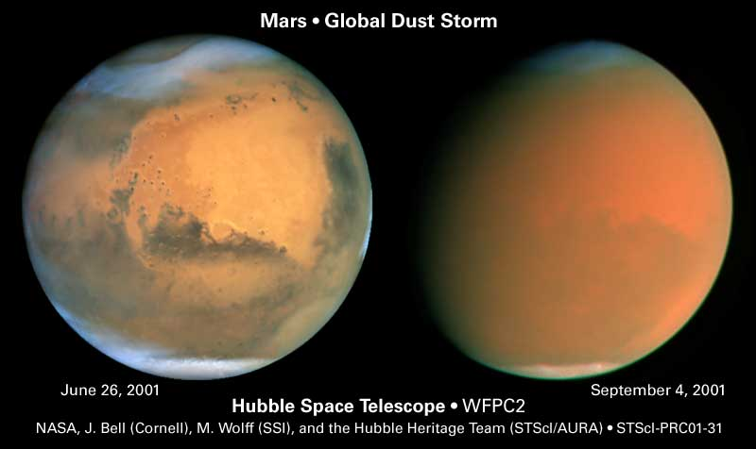
Dust is pervasive on Mars…
Notes:
Add a background context/motivation slide before this one? See Ojha et al 2018 1st paragraph

Slide 3
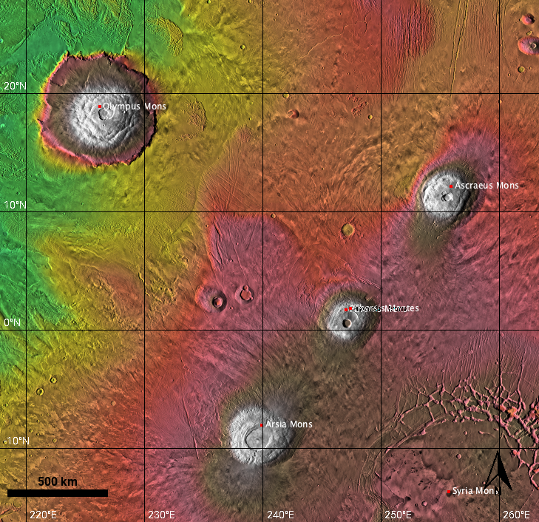
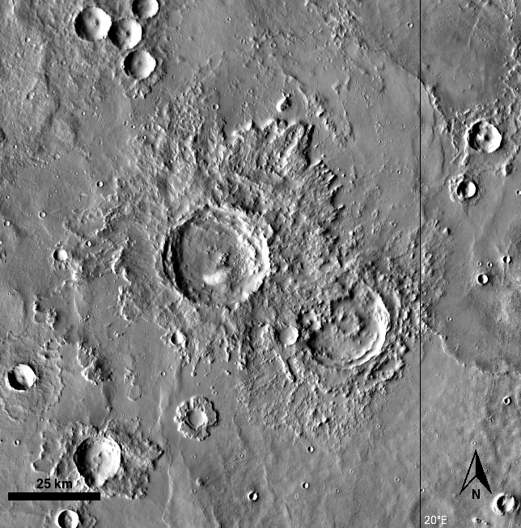
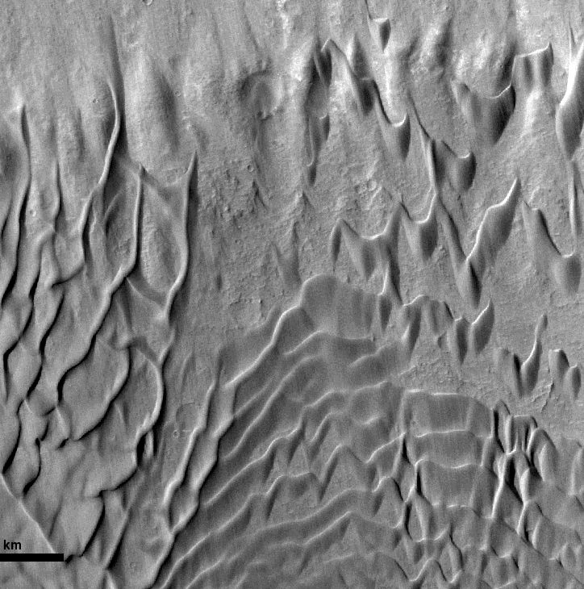
… But its origin is unknown
Volcanics
Impacts
Wind-blown sand
Tharsis Montes Region
Impact craters and ejecta blankets
Bagnold Dune Field
Notes:
FIGURES
This slide: Ojha et al 2018 3rd paragraph (volcanic ash and explosive volcanic deposits, fragmentation of local rocks from impact cratering. Lack of water and active volcanism on modern Mars)
Volcanos produce a “wide size range of deposits” – stay away from the word “ash” and “pyroclastics”

Slide 4
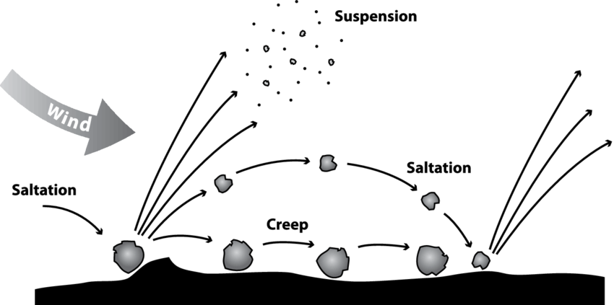
This modification occurs during aeolian transport
Sand is ubiquitous on Mars
Wind has been a dominant process of sediment transport on Mars for 3.6 billion years
Wind moves sand via saltation
On Earth, sand grains undergo collisions with transport
These collisions can lead to the release of small particles from the grain
Tatarko & Presley (2009). Principles of Wind Erosion and its Control.
Notes:
Add terrestrial evidence, left terrestrial right mars?
Add figure number and citation

Slide 5
Dust may be produced during transport by two mechanisms
Angular grains become more rounded with increased transport distance
Break-off of irregularities
Sand grains can develop iron-rich coatings
Release of dust-sized particles from these coatings
Angular grains – volcanic tephra
Coated grains – Coral Pink Sand Dunes
Notes:
Show zoomed-in, less grains to highlight roundness vs angularity
Sources, sources, sources.
REPLACE PICTURES: Zoomed-in for CPSD and PCT
Is ”iron-rich” relevant in this context?

Slide 6
We evaluate these mechanisms experimentally
Simulating aeolian transport
Examine the relative contribution to dust
Release of iron-oxide coatings vs. removal of irregularities from angular grains.

Slide 7

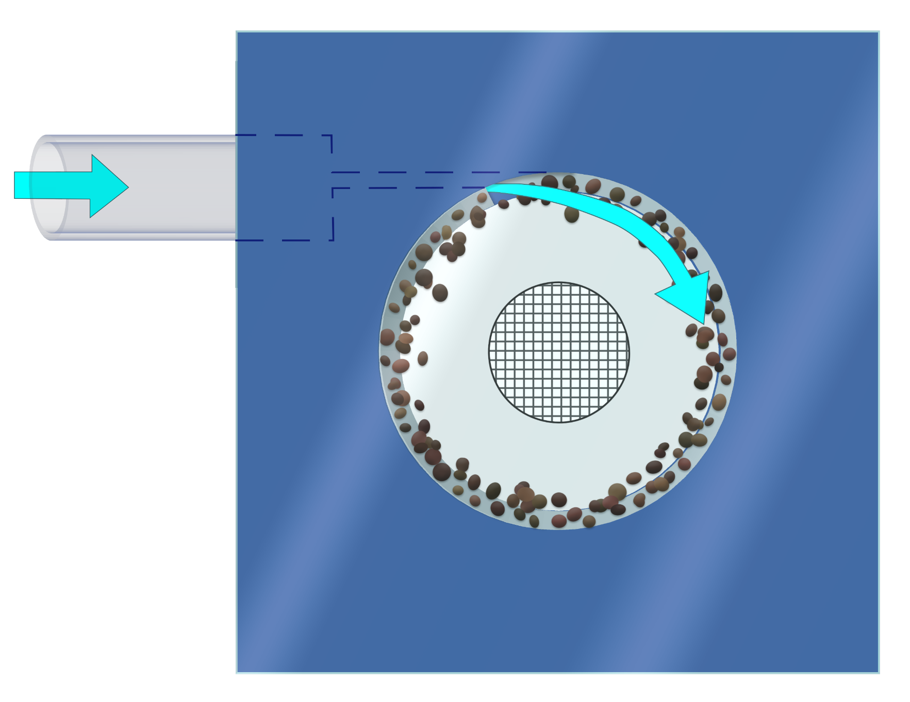
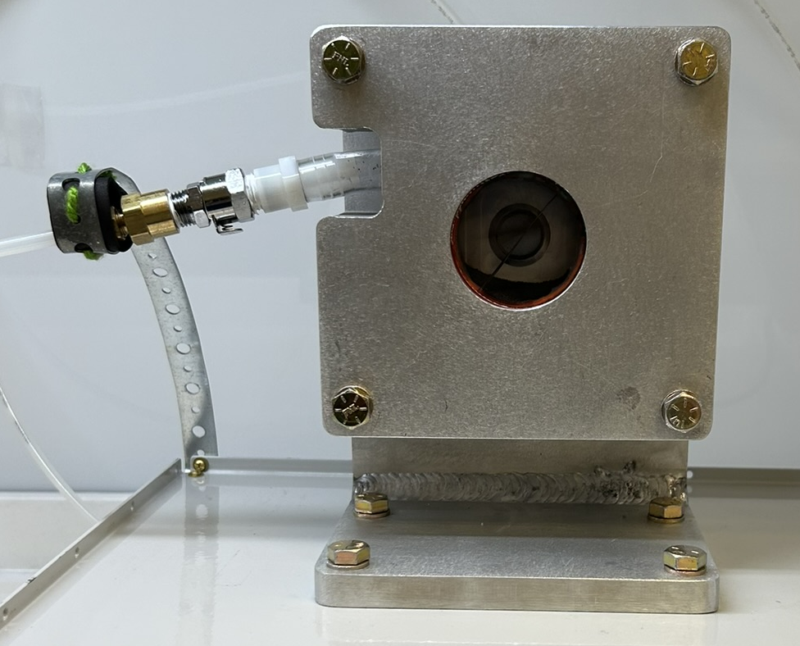
We simulate aeolian transport with the Mill for Aeolian Experiments (MAE)
Air inlet
Air inlet
Air exit
Front panel glass treated with anti-static solution
5 cm
Silicone gaskets
Sediment circulating within MAE chamber will undergo grain-to-grain and grain-to-mill collisions
Transport velocities within the chamber are adjusted to match those on Mars
Notes:
Effects of pressure are negligible, relative collision velocities provide meaningful results, as long as collisions are occurring we’re seeing dust production

Slide 8
We’re using two Mars-analog sediments
Sediment Matrix
Material | Mars Analog | Processing | Purpose
Pisgah Crater Tephra | Basaltic Sand | Unprocessed | Removal of irregularities
Coral Pink Sand Dunes | Iron oxide coatings | Unprocessed | Release of coating material
 |  | Washed | No coatings, control
 |  | Crushed, unwashed | Roundness and coatings
 |  | Crushed, washed | Roundness, no coatings

Slide 9
The Coral Pink Sand Dune sediment requires additional preparation
Comparison for contribution of coatings: Washed vs. Unwashed
Washed sediment is boiled in 10% HCl for 10 minutes to remove coatings
Sediment is weighed before and after washing to determine mass loss of and % coating on grains
Visible/Near-Infrared Spectroscopy taken before and after washing to determine comparative change in iron oxide content
Washed grains should show no absorption signatures in iron oxide bands
Comparison to Pisgah Crater Tephra
A subsample of washed and unwashed sediment will be crushed to increase angularity
Notes:
Add images of all 4 CPSD

Slide 10
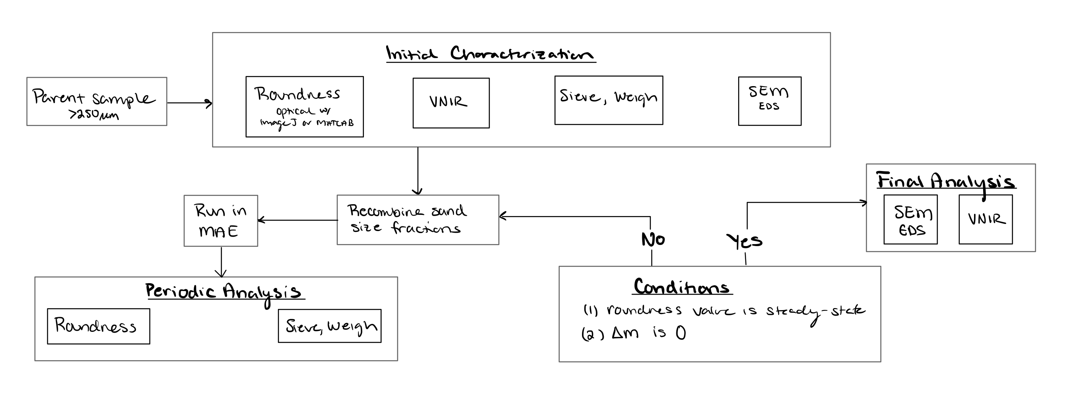
Use of the MAE is iterative
Sediment is run through the mill until a steady state is reached
Roundness value
Change in mass
Notes:
This flow chart will set up the results with the time stamps on the next page

Slide 11
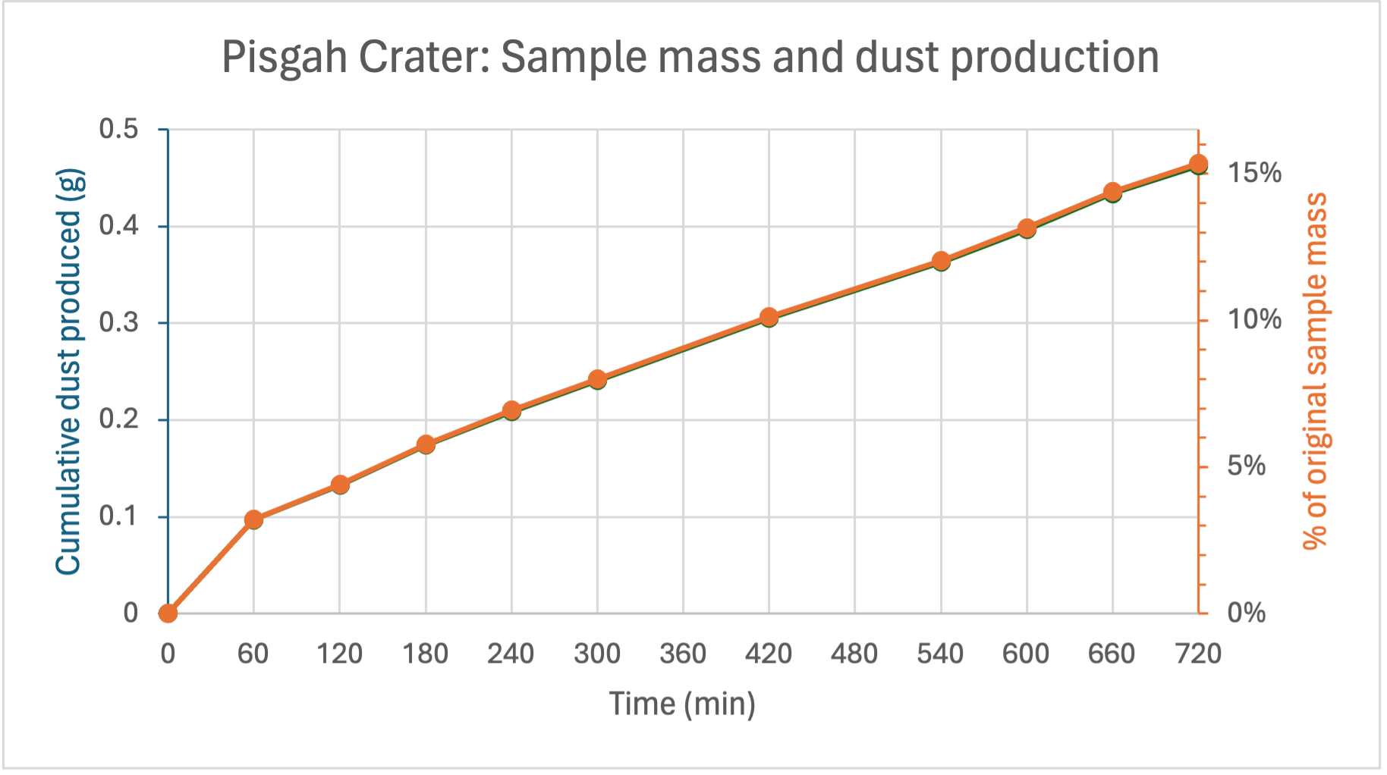
Dust production is confirmed via mass loss for Pisgah Crater Tephra
15 hours of abrasion time
15% of total mass comminuted to dust
Not yet reached mass loss steady-state

Slide 12

Future Work
All 4 variations of Coral Pink Sand Dune sediment will be tested and analyzed
Mass loss results will be included for additional Mars-analog and monomineralic sediments
Thank you!
Thank you to Dr. Devon Burr, Anna Baker, Paloma Davidson, Vernon Rich of Rich Precision Fabrication Inc., and the Arizona Space Grant Consortium

